Slide 1
HOME AUTOMATION SYSTEM & ANALYSIS
1:ASHISH KOTHARI
2:SNEHAL SURVE
3:ADESH THOSANI
PROJECT GUIDE: PROF. ARCHANA KOTANGALE

Slide 2
Abstract
This project presents the overall design of Home Automation System (HAS) with low cost and wireless system . This system is designed to assist and provide support in order to fulfill the needs of elderly and disabled in home . Also, the smart home concept in the system improves the standard living at home. The main control system implements wireless technology to provide remote access from smart phone .The system intended to control electrical appliances and devices in house with relatively low cost design, user-friendly interface and ease of installation. This paper explains the evolution of device fingerprinting concept over time, and discusses various pitfalls in existing device fingerprinting approaches. In this paper, we propose a two-stage verification process for smart homes, using device fingerprints and login credentials, which verifies the user device as well as the user accessing the home over the Internet. The main control system implements wireless technology to provide remote access from smart phone.

Slide 3
INTRODUCTION
The concept of Home Automation was a topic of interest in the Academic arena since the late 1970s, with time and advancement of technology people’s expectations about Home Automation and how they should access their home has dramatically changed.
A modern Home Automation System must identify, alert and prevent an intrusion attempt in a home; it must also try to preserve evidence of the intrusion or attempted intrusion, so the perpetuator can be brought to justice.
HASs includes centralized control of lighting, appliances, security locks of gates and doors and other systems, to provide improved comfort, energy efficiency and security system. HASs becoming popular nowadays and enter quickly in this emerging market. However, end users, especially the disabled and elderly due to their complexity and cost, do not always accept these systems.

Slide 4
Literature
As per our survey, there exist many systems that can control home appliances using android based phones/tablets. Each system has its unique features. Currently certain companies are officially registered and are working to provide better home automation system features. Following models describes the work being performed by others. The use of socket programming is performed to connect the android application with the raspberry pi. This further adds security to our system. The data are received only by the server at the specified port and data are further analyzed. Our project is different in a sense it has its own software level application to control the home appliances.
N. Sriskanthan [7] explained the model for home automation using bluetooth via PC. But unfortunately the system lacks to support mobile technology.
Muhammad Izhar Ramli [8] designed a prototype electrical device control system using Web. They also set the server with auto restart if the server condition is currently down.
Amul Jadhav [10] developed an application in a universal XML format which can be easily ported to any other mobile devices rather than targeting a single platform. Each of these system has their own unique features and on comparison to one another lacks some advancement

Slide 5
DOMAIN:-
Internet of things(IOT)
Machine Learning
Data Analysis
Cloud Computing
Python
KEYWORD:-
Home automation
smart homes
identity management systems
security access control

Slide 6
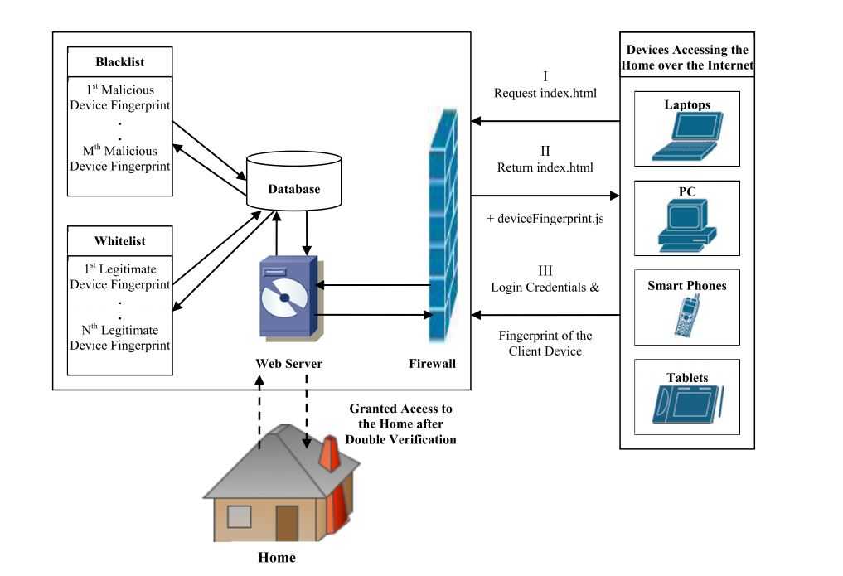

Slide 7
Project Objectives
Android controlled Smart Home Automation should be able to control the home appliances wirelessly , effectively and efficiently.
Controlling Home Appliances via Application (Switch) .To develop an application that includes the features of switches application.
Switch Mode can be used to control the switches of home appliances.
Real Time Video Streaming from IP camera to receive the quality video from the camera to the android application.
Secure Connection Channels between Application and Raspberry pi
Use of secure protocols over Wi-Fi so that other devices cannot control the appliances.
Options for secure connection is SSL over TCP, SSH controlled by any device capable of Wi-Fi (Android, iOS, PC).
To make the home appliances flexible in control, any device capable of Wi-Fi connectivity will able to control the home appliances from remote location.
Extensible platform for future enhancement
The application is to be highly extensible, with possibility of adding features in the future as needed.

Slide 8
Scopes
The project aims at designing a prototype for controlling the home appliances that can be controlled wirelessly via an application that provides the features of speech recognition, video streaming, and switch mode.
An application runs on android device.The system can be used in wide range of areas. The system integrated with different features can be applied in the following fields .The system can be used in home, small offices to the big malls The system can be used from home to offices to control the electrical appliances.
For remote access of appliances in internet or intranet. The home/office appliances can be controlled in intra-network or can be accessed via internet.
For the development of technology friendly environment The system incorporates the use of technology and making smart home automation. By the use of day to day gadgets we can utilize them for different prospective.

Slide 9
TECHNOLOGY STACK
Google’s Android open source technology.
JAVA DEVLOPMENT KIT
Wi-Fi technology.
Interfacing Wireless Adapter to Raspberry pi.
Interfacing relays with ac and dc power sources.
Using Transistor as a Switch.
Embedded programming.
Tensor Flow.

Slide 10
CONCLUSION
The device fingerprint along with username/password based security proposed in this paper, enables the verification of user as well as the device used to access the home, which significantly improves home security when they are accessed over the internet. In our work, the device fingerprinting algorithm was able to uniquely identify 97.93% of devices accessing our test website with an entropy of over 22 bits. Unlike any previous approaches to device fingerprinting, we use geolocation data in our algorithm which improves the fingerprint accuracy

Slide 11
REFERENCE
https://ieeexplore.ieee.org/stamp/stamp.jsp?tp=&arnumber=7563403
https://en.wikipedia.org/wiki/Home_automation
N. Sriskanthan and Tan Karand. “Bluetooth Based Home Automation System”. Journal of Microprocessors and Microsystems, Vol. 26, pp.281-289, 2002.

